Slide 1
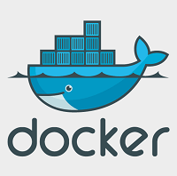
Selenium Grid With Docker

Slide 2
Selenium Grid
Selenium Grid allows the execution of WebDriver scripts on remote machines by routing commands sent by the client to remote browser instances.
Grid aims to:
Provide an easy way to run tests in parallel on multiple machines
Allow testing on different browser versions
Enable cross platform testing

Slide 3
When would you use a Selenium Grid?
To run your tests in parallel, against different browser types, browser versions, operating systems
To reduce the time needed to execute a test suite

Slide 4
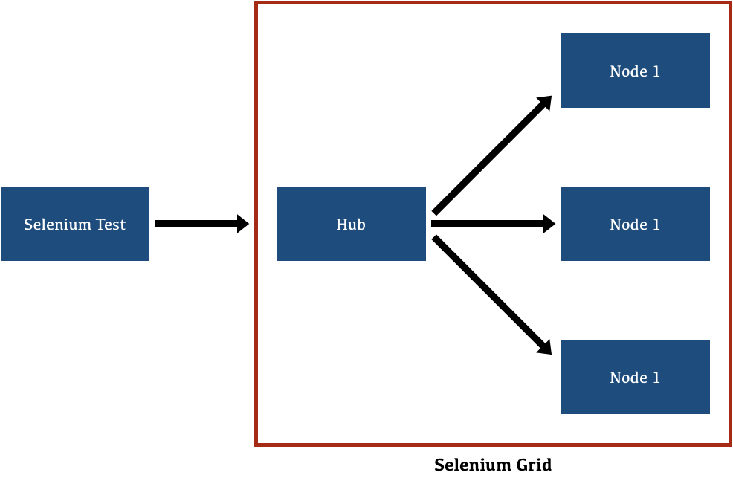
Grid Architecture

Slide 5
Docker
Docker is an open-source centralized platform designed to create, deploy, and run applications.
Docker uses container on the host's operating system to run applications.
It allows applications to use the same Linux kernel as a system on the host computer, rather than creating a whole virtual operating system.
Containers ensure that our application works in any environment like development, test, or production.

Slide 6
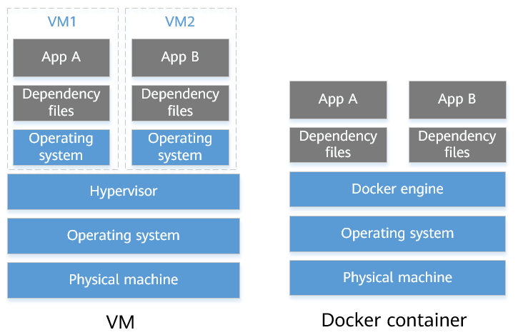
Docker Architecture

Slide 7
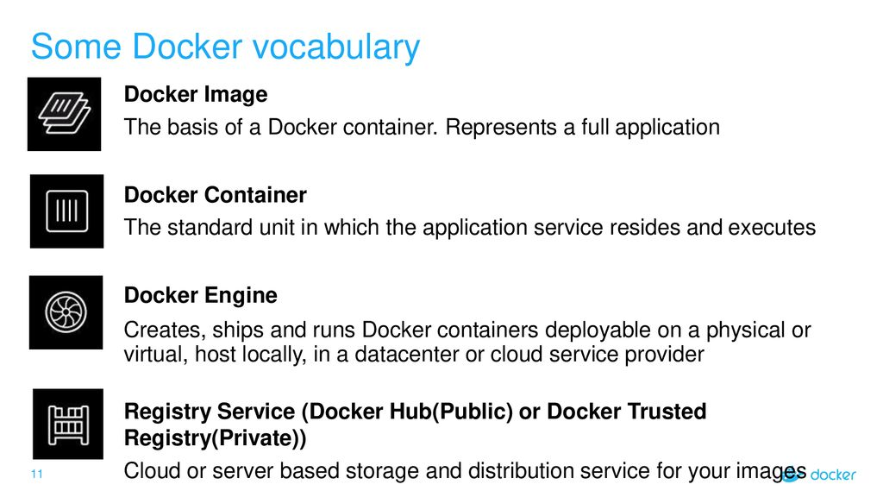

Slide 8
Docker Commands
To check version
docker –version
To check information
docker info
To get all commands
docker –help
To get specific command meaning
docker command –help
To get list of images
docker images
To add images
docker pull image
To remove docker image
docker rmi imageid
To display list of containers
docker ps

Slide 9
Selenium Automation on Docker
Download selenium/standalone-chrome:latest image
docker pull selenium/standalone-chrome
To create container use run command
docker run -d -p 4444:4444 --shm-size="2g" selenium/standalone-chrome:latest
Write script and run testcase

Slide 10
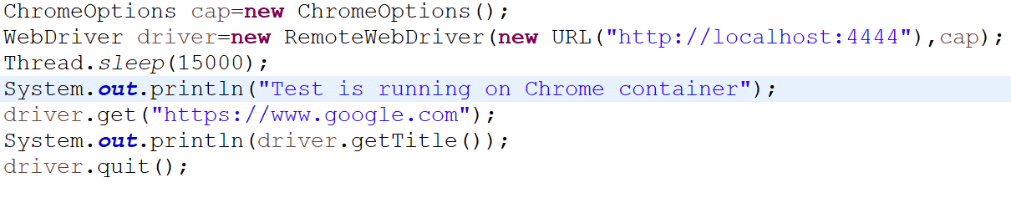
Script

Slide 11
Cross Browser Test
Create Images then container
Download Selenium/hub
docker pull selenium/hub
Download selenium/node-chrome
docker pull selenium/node-chrome
Download selenium/node-firefox
docker pull selenium/node-firefox

Slide 12
Prerequisite
docker network create grid
docker run -d -p 4442-4444:4442-4444 --net grid --name selenium-hub selenium/hub:4.6.0-20221104
docker run -d --net grid -e SE_EVENT_BUS_HOST=selenium-hub --shm-size="2g" -e SE_EVENT_BUS_PUBLISH_PORT=4442 -e SE_EVENT_BUS_SUBSCRIBE_PORT=4443 selenium/node-chrome:latest
docker run -d --net grid -e SE_EVENT_BUS_HOST=selenium-hub --shm-size="2g" -e SE_EVENT_BUS_PUBLISH_PORT=4442 -e SE_EVENT_BUS_SUBSCRIBE_PORT=4443 selenium/node-edge:latest
docker run -d --net grid -e SE_EVENT_BUS_HOST=selenium-hub --shm-size="2g" -e SE_EVENT_BUS_PUBLISH_PORT=4442 -e SE_EVENT_BUS_SUBSCRIBE_PORT=4443 selenium/node-firefox:latest

Slide 13
Docker Selenium Hub sites
https://github.com/SeleniumHQ/docker-selenium
https://hub.docker.com/

